Slide 1
Gym Members Exercise Analysis
By Ruben Sistach
Ben Abromowich, Mike Foley
Hailin Chen
Notes:
mike

Slide 2
Why we chose this topic?
We all value health and exercise
All of us exercise weekly
We wanted to explore how exercise and hydration affects people differently
Notes:
mike

Slide 3
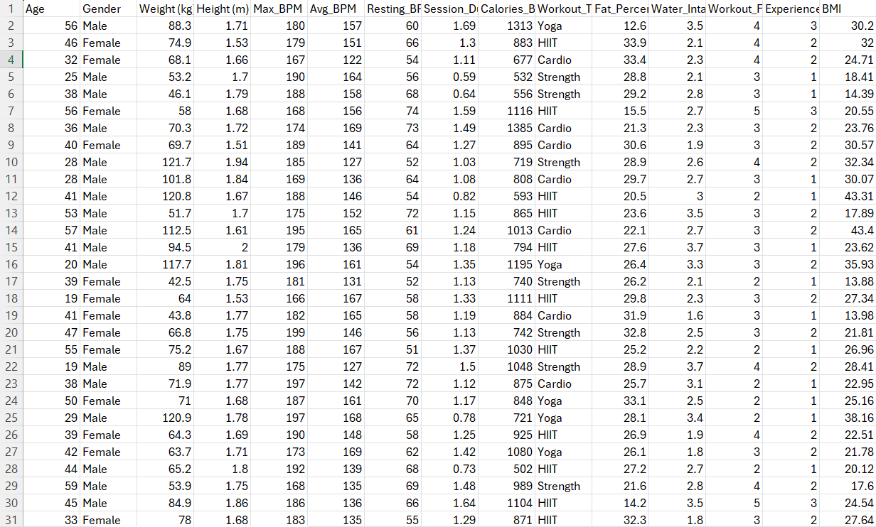
Our Data
https://www.kaggle.com/datasets/valakhorasani/gym-members-exercise-dataset
Data Description:
This dataset has information on gym members, including their workouts, fitness stats, and personal details.
It shows things like heart rate, calories burned, workout time, experience level, and other demographic info.
Notes:
Ben

Slide 4
RESEARCH QUESTIONS
How does age affect calories burned?
Does experience level influence workout frequency?
Does experience level relate to body fat percentage?
Does average heart rate affect calories burned?
Is daily water intake associated with lower body fat percentage?
Linear regression: Session duration vs Calories burned

Slide 5

Tools used
Pandas - Manage data
Seaborn - Visuals
Sklearn - Linear Regression
Notes:
Ben

Slide 6
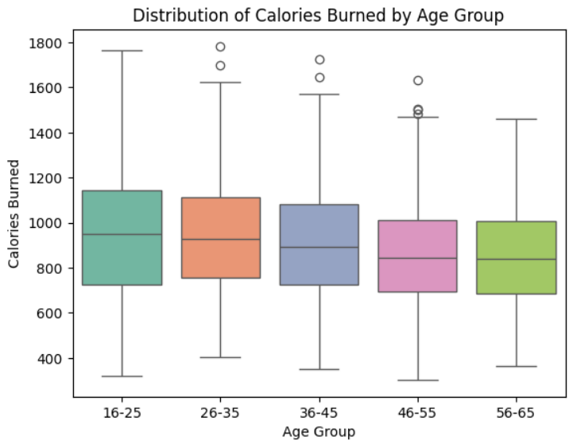
How does age affect calories burned?
Ages 16–25 show the highest median calorie burn
Older groups (56–65) have a lower median and tighter spread
All age groups display notable outliers
All of the age groups median is in between 800 to 1000 calories burned
Notes:
Ben

Slide 7
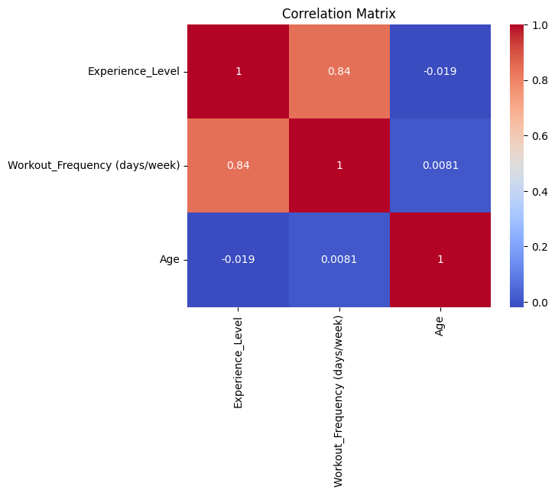
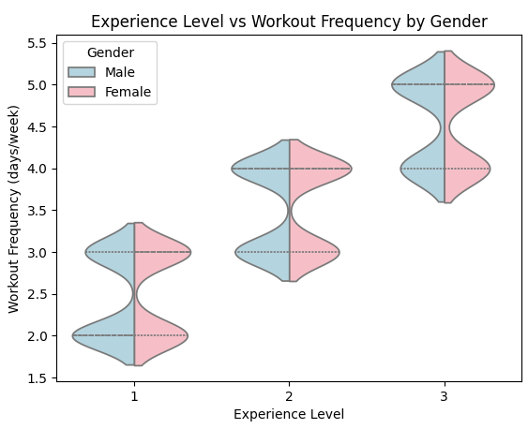
Does experience level influence workout frequency?
Wanted to see how frequency was affected by level, does age and gender also affect it?
Heat map shows frequency and level are positively correlated, age is not.
Violin graph shows the distribution of frequency in each level, frequency increases with level.
Violin shows that gender within level does not impact frequency at all.
Notes:
mike

Slide 8
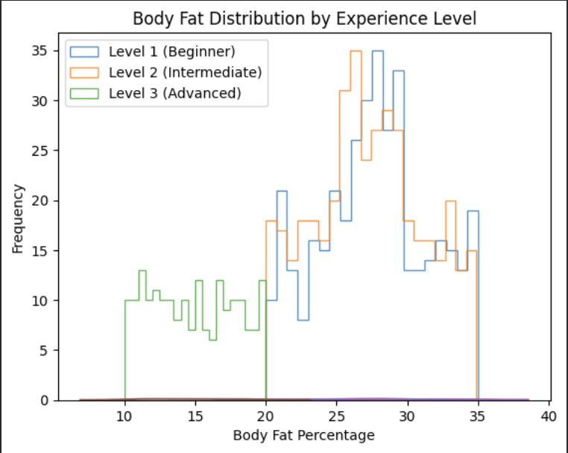
Does experience level relate to body fat percentage?
Beginners have higher body fat
Advanced people have lower body fat
Distribution shifts lower with experience
Notes:
Hailin

Slide 9
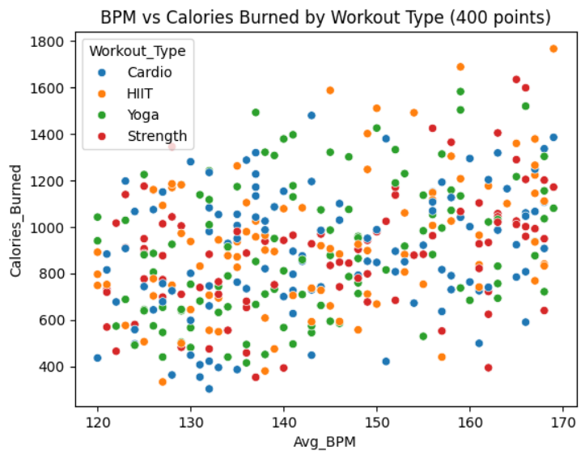
Does average heart rate affect calories burned?
Prediction: when you have a high heart rate while exercising you would assume they are doing cardio or they are doing a high intensity lifts. Cardio should burn the most calories with HIIT being a close second.

Slide 10
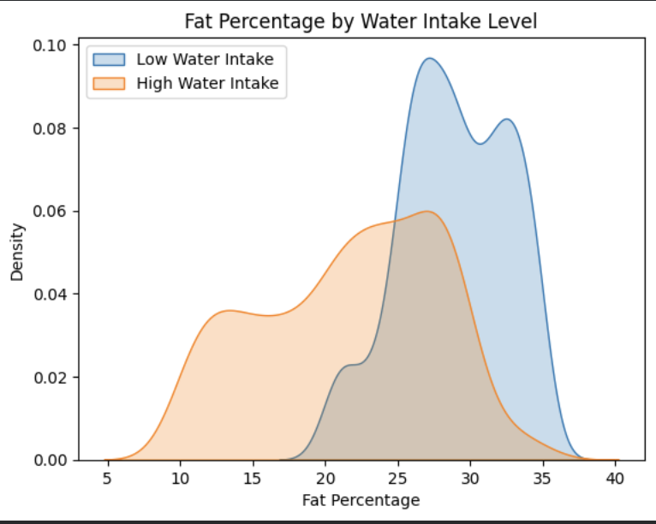
Is daily water intake associated with lower body fat percentage?
People with water intake below median are most clustered around the 25-35% body fat percentage
People with higher water intake are more evenly spread from ~ 12.5-27.5%
Note that the overlap is likely from the cut off from the median
Water intake likely is very correlated to body fat percentage
Notes:
mike

Slide 11
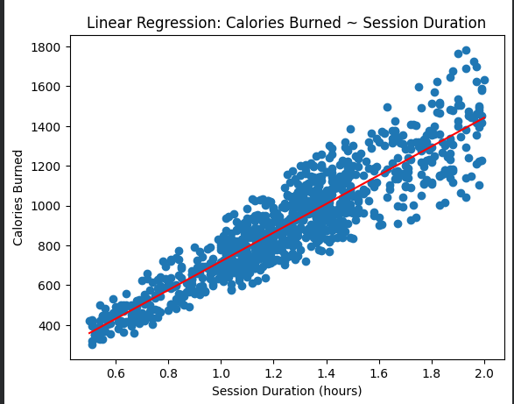
Session Duration vs Calories Burnt
Strong linear relationship
Duration predicts calories
Clear trend
Notes:
Hailin

Slide 12
Conclusion:
Exercise outcomes are intuitive, the data affirms that by taking care of your body through exercise and hydration, you can get good results regardless of gender or age.
Future Research:
Gender
Max heart rate
With a different Dataset
Health risk modeling
How certain movements affect progress

Slide 13
Thank you!

